Slide 1
Latent Damage and Reliability in Semiconductor Devices
May1625 - Advisor & Client: Dr. Randy Geiger
Sean Santella Hayle Olson David Ackerman Jaehyuk Han
04/27/16
Notes:
Hayle

Slide 2
Latent Damage and Reliability in Semiconductor Devices
What is Latent Damage?
Is usually caused by an Electrostatic Discharge (ESD) event
Physically damages a device but is electrically undetectable
A device that has been latently damaged is still functional but may fail much sooner than expected.
Notes:
Jaehyuk
Jaehyuk, here is what I have on my note card from when I read this slide…
Now, your first question might be what is Latent Damage?
Latent Damage is usually caused by an ESD event, a sudden electric shock.
This ESD event can cause physical damage, but this damage is undetectable electrically.
Ultimately, this undetectable latent damage will reduce the lifetime of the device.

Slide 3
Latent Damage and Reliability in Semiconductor Devices
Does Latent Damage exist?
Some studies show that latent damage exists, while others don’t
Latent damage is an on-going debate in the semiconductor industry
Study will examine bulk CMOS Commercial off-the-Shelf (COTS) devices
COTS devices typically have a Mean Time to Failure (MTTF) of 20 years
Notes:
Jaehyuk

Slide 4
Latent Damage and Reliability in Semiconductor Devices
Why should we care?
System with Latently Damaged COTS Devices
Reliability
Concerns
Standard Repair Procedure Would Not Apply
Extremely High Cost of Repair
Profit Loss
Notes:
Jaehyuk

Slide 5
Latent Damage and Reliability in Semiconductor Devices
Hypothesis
If a non-catastrophic ESD event occurs on a semiconductor device, then latent damage exists.
This latent damage can cause the reliability of these devices to decrease.
Resulting in the MTTF to be shorter than the manufacturing specifications.
Notes:
Hayle

Slide 6
Latent Damage and Reliability in Semiconductor Devices
Overall Project Plan
Destroy 50% of our devices
Stress devices
Accelerate the lifetime of the “functional” devices
Burn-in testing
Observe and analyze the MTTF
Data analysis
An experiment with three parts:
ESD Stress
Accelerate Lifetime
Data Analysis
Notes:
Hayle
In the 1st portion of our project we are exposing our devices to a high voltage pulse. This pulse is calculated to destroy roughly 50% of our devices. This will show us that damage is happening within the devices.
The next step is to speed up the lifetime of our still functional devices. Here, functional is noted with quotation marks, because we’re assuming that there is some internal damage that is undetectable.
Once all of the devices have reached their lifetime our final step is to observe and analyze their Mean Time to Failure. We will use these results to compare to their expected lifetime to prove our hypothesis.
Some existing work has already been done on this topic here at Iowa State.
To stay within time and budget constraints we attempted to use/repurpose the existing Printed Circuit Boards (PCBs).

Slide 7
Latent Damage and Reliability in Semiconductor Devices
ESD Stress
Notes:
Hayle - transition to Sean

Slide 8
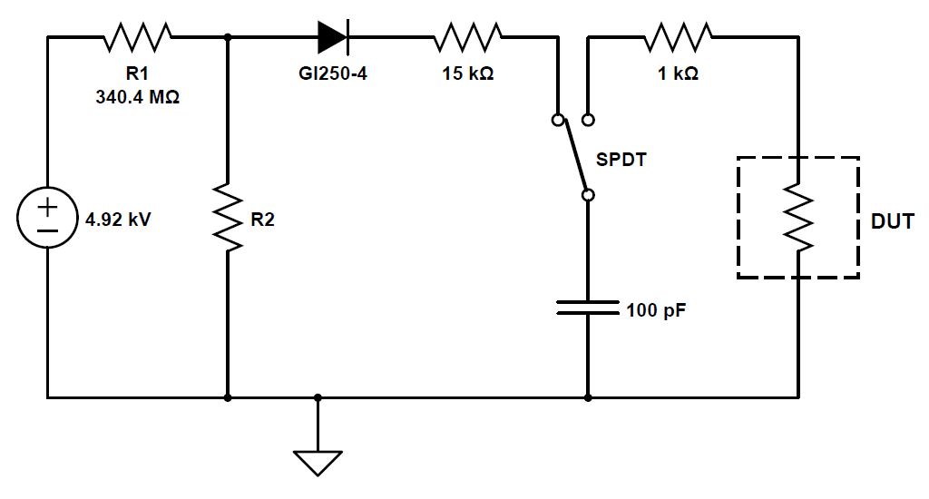
Latent Damage and Reliability in Semiconductor Devices
ESD Stress
----------------------------------------------------------------------------------------------------------------------------------------------------------------
General Procedure
Devices will be exposed to an ESD event at a high-voltage level
Human Body Model (HBM)
100pF Capacitor charged to a high-voltage
Discharged into Device Under-Test (DUT) with the output tied low
Texas Instruments (CD4049UBE)
6 CMOS inverters on one chip (hex inverter)
Determine a maximum stress level
Notes:
Sean

Slide 9
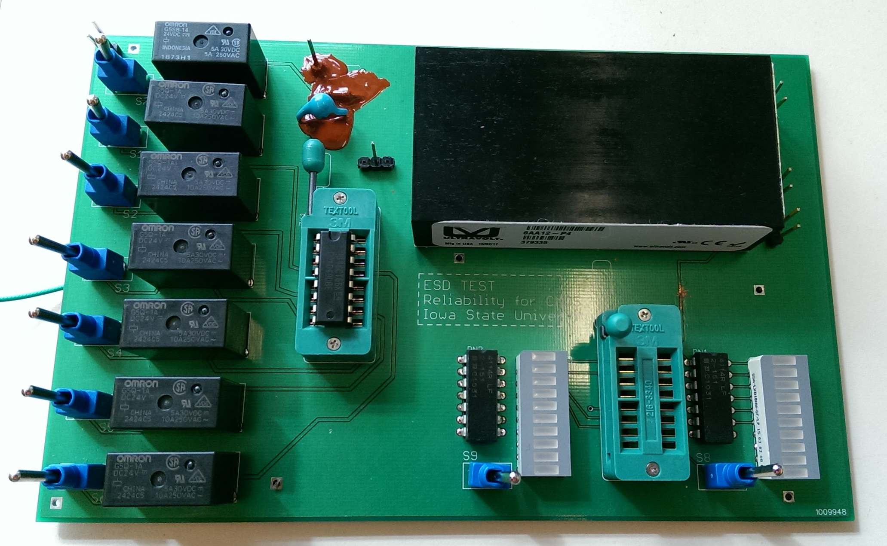
Latent Damage and Reliability in Semiconductor Devices
ESD Stress
-------------------------------------------------------------------------------------------------------------------------------------------------
PCB
An ESD Stress PCB was previously created
Simulate an ESD event
Functionality check
Programmable high-voltage source was non-functional
Re-purposed the PCB to use an agriculturally purposed high-voltage source
100pf Capacitor
DUT
Notes:
Sean

Slide 10
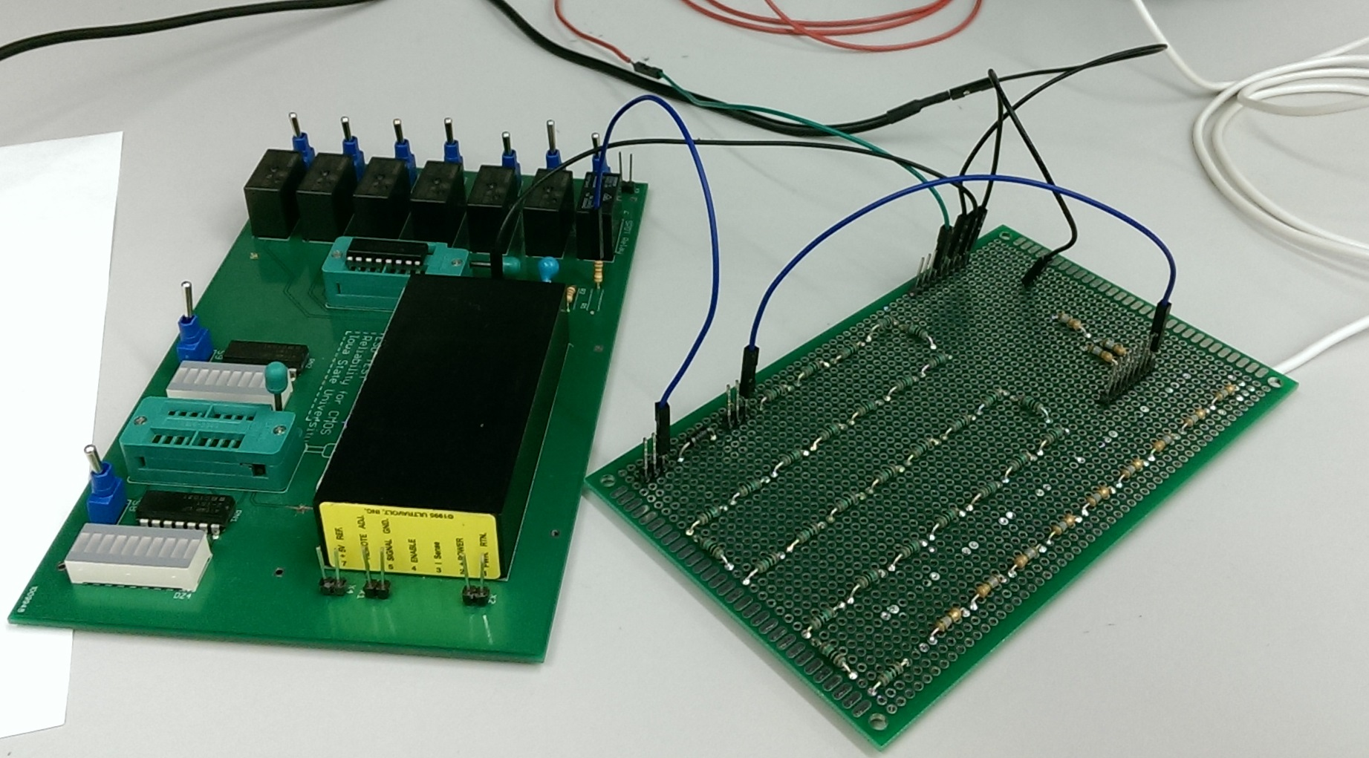
Latent Damage and Reliability in Semiconductor Devices
ESD Stress Setup
Charge/Discharge to DUT
HV Stepped Down
HV Input
DUT
R2
R1
GI250-4 Diode
Voltage Divider
Notes:
Sean

Slide 11
Latent Damage and Reliability in Semiconductor Devices
ESD Stress
-------------------------------------------------------------------------------------------------------------------------------------------------
Challenges
High-voltage source has high frequency content
High-speed diodes are required to minimize the effects
Typically do not have large reverse breakdown voltages (V_{R})
A high V_{R} is required to keep the capacitor charged during the negative cycle of the voltage source
A diode with a V_{R} of 4kV was used (Vishay SUPERECTIFIER GI250-4)
Oscilloscope can only handle roughly 850V_{PP}
Designed and soldered an attenuator to check voltage on capacitor
The only way to verify that the ESD Stress setup is working is to catastrophically damage a device with a high-voltage discharge
Components and devices used in the setup have to be soldered and insulated properly
Notes:
Sean

Slide 12
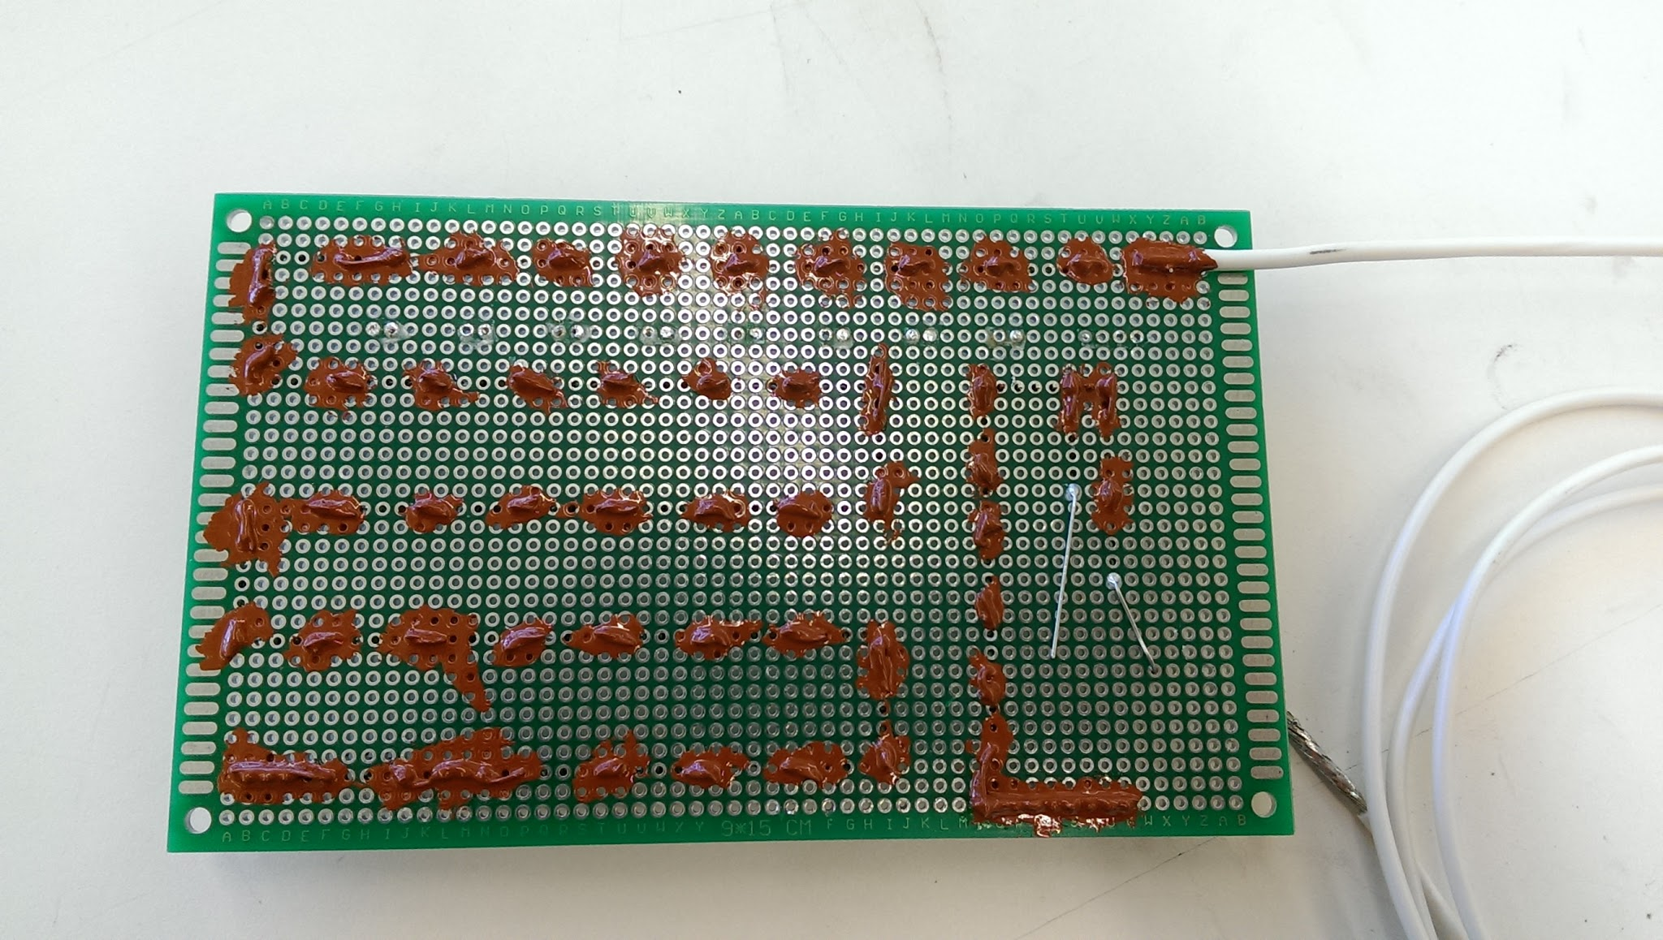
Latent Damage and Reliability in Semiconductor Devices
Insulating Varnish
Notes:
Sean [Technical Challenge]

Slide 13
Latent Damage and Reliability in Semiconductor Devices
Stressing a Device
Notes:
Sean
Or we have another video: https://youtu.be/FY50HXzT4bQ

Slide 14
Latent Damage and Reliability in Semiconductor Devices
Test Samples
100 non-stressed devices
200 new devices
Control Group
100 non-stressed devices
1 week of burn-in to acquire baseline data
Experimental Group
100 stressed devices
1 week of burn-in
ESD Stress
100 failed devices
100 stressed devices
Control Group
Experimental Group
Accelerate Lifetime (Burn-in)
Notes:
Sean

Slide 15
Latent Damage and Reliability in Semiconductor Devices
Lifetime Acceleration
Notes:
Sean - transition to Hayle

Slide 16
Latent Damage and Reliability in Semiconductor Devices
Burn-in
---------------------------------------------------------------------------------------------------------------------------------------------------------------------------------------------------------------
General Procedure
Once the parts are stressed, they are put into a burn-in oven.
The burn-in oven is used to accelerate the lifetime of the devices.
112°C
MTTF acceleration: 20 years to 1 week
DUTS are in a high-stress mode of operation
These parts will be checked regularly during the burn-in to determine if a failure has occurred.
Notes:
Hayle [Technical Challenge]
//Otherwise, we would need to wait decades to test the parts’ MTTF

Slide 17
Latent Damage and Reliability in Semiconductor Devices
Burn-in
---------------------------------------------------------------------------------------------------------------------------------------------------------------------------------------------------------------
PCB
The PCB used to hold, test, and burn-in devices have two modes of operation:
Further stress devices while in burn-in, by holding the output of DUTs at their trip point.
Test the digital logic functionality of the devices, by disconnecting the output of the DUTs, to check when the devices failed.
Notes:
Hayle

Slide 18
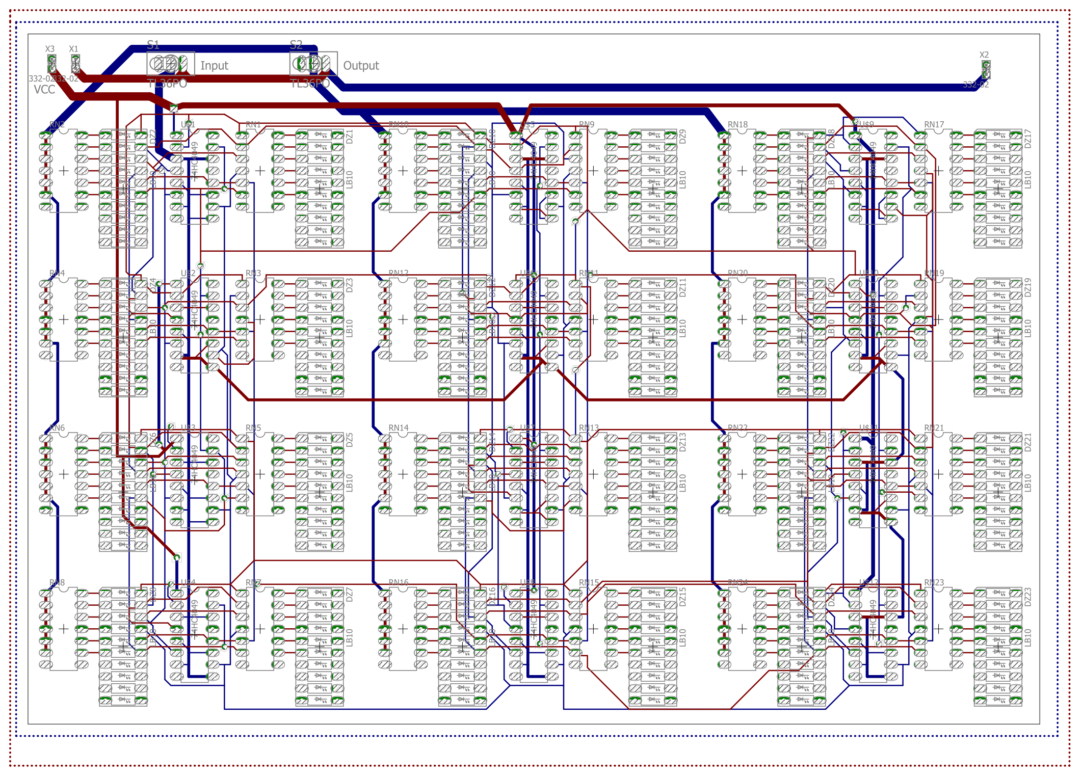
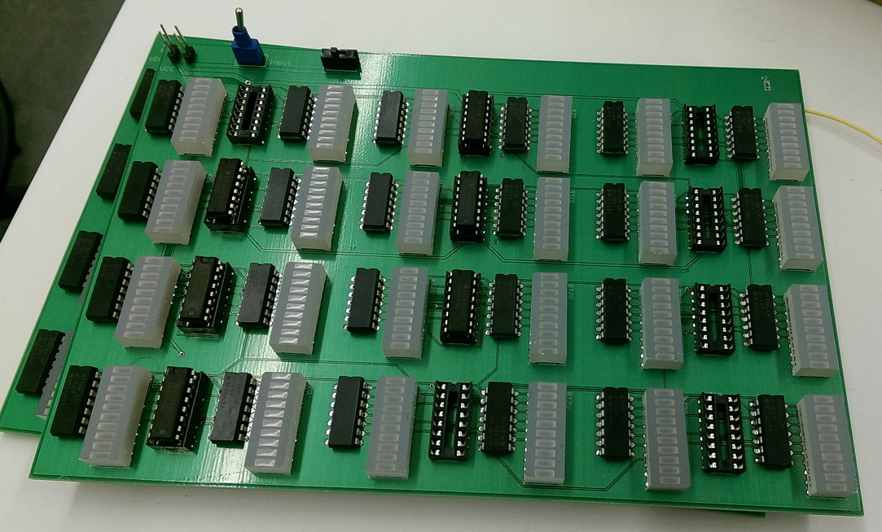
Latent Damage and Reliability in Semiconductor Devices
Burn-in PCB
------------------------------------------------------------------------------------------------------------------------------------
1st Design
12 Testing Clusters per PCB
1 Testing Cluster
Notes:
Hayle

Slide 19
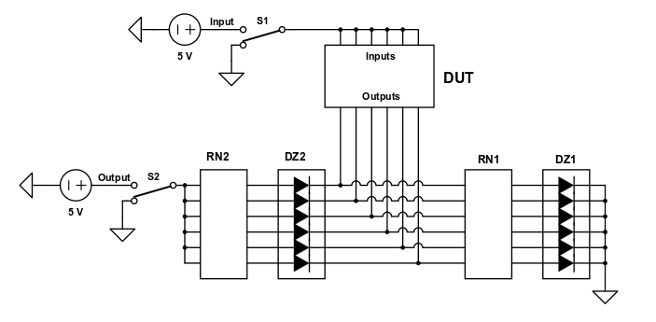
Latent Damage and Reliability in Semiconductor Devices
Burn-in PCB
------------------------------------------------------------------------------------------------------------------------------------
1st Design
The bread board on the left is to test a single hex-inverter
Circuit schematic:
Notes:
David
//This can be accomplished by showing this as the old design we had last semester, and then comparing it to the new design. The particulars aren’t important, but the differences are.

Slide 20
Latent Damage and Reliability in Semiconductor Devices
Burn-in PCB
------------------------------------------------------------------------------------------------------------------------------------
Functionality Check
In the table below, 1 means “high” for the switch states, and 1 means conducting for the components.
Switch |  | Diodes |  | Inverter Transistors
“Input” | “Output” | DZ1 | DZ2 | PMOS | NMOS
0 | 0 | 1 | 0 | 1 | 0
0 | 1 | 1 | 0 | 1 | 0
1 | 0 | 0 | 0 | 0 | 1
1 | 1 | 0 | 1 | 0 | 1
Notes:
David

Slide 21
Latent Damage and Reliability in Semiconductor Devices
Burn-in PCB
------------------------------------------------------------------------------------------------------------------------------------
Functionality Check
Notes:
David
Or we have another video:

Slide 22
Latent Damage and Reliability in Semiconductor Devices
Burn-in PCB
------------------------------------------------------------------------------------------------------------------------------------
1st Design - Issues
Resistor networks in the testing set-up are bussed instead of isolated.
All output gates of each testing setup are connected with other output gates
These are design flaws that broke functionality of the old boards.
We chose to make new boards to solve these issues.
Notes:
David [2 Technical Challenges]

Slide 23
Latent Damage and Reliability in Semiconductor Devices
Burn-in PCB
------------------------------------------------------------------------------------------------------------------------------------
1st Design - Issues
Resistor networks in the testing set-up are bussed instead of isolated.
The LEDs are the visual indicators for collecting burn-in data; they need to work accurately
Bussed Resistor Network
Isolated Resistor Network
Notes:
David
Briefly show this slide

Slide 24
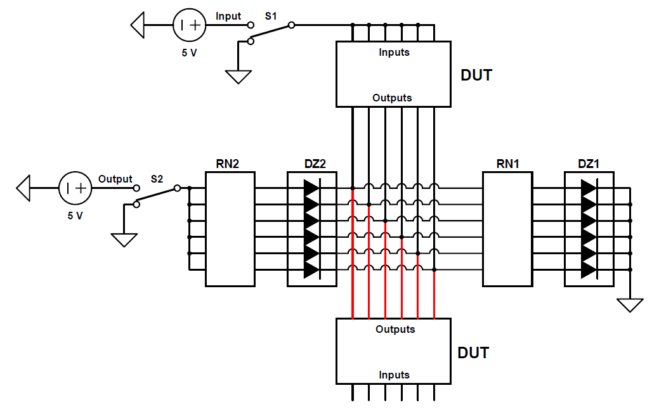
Latent Damage and Reliability in Semiconductor Devices
Burn-in PCB
------------------------------------------------------------------------------------------------------------------------------------
1st Design - Issues
Output gates of each testing setup are connected with other output gates
Notes:
David
Briefly show this slide

Slide 25
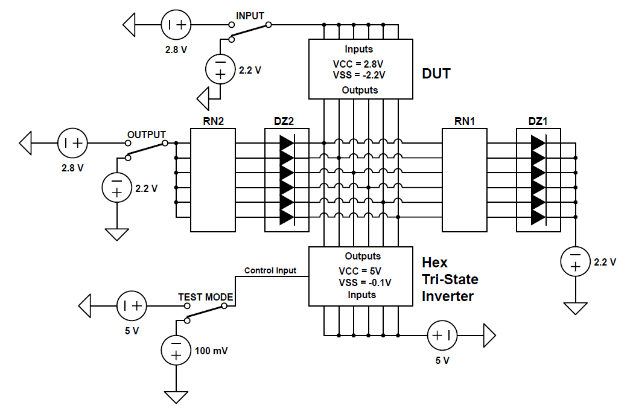
Latent Damage and Reliability in Semiconductor Devices
Burn-in PCB
------------------------------------------------------------------------------------------------------------------------------------
2nd Design
New circuitry to allow electronic switching of operation modes
Output of DUT is either at the trip point or floating (disconnected) relative to the tri-states
Notes:
David [Technical Challenge]
Picture of breadboards is on next slide

Slide 26
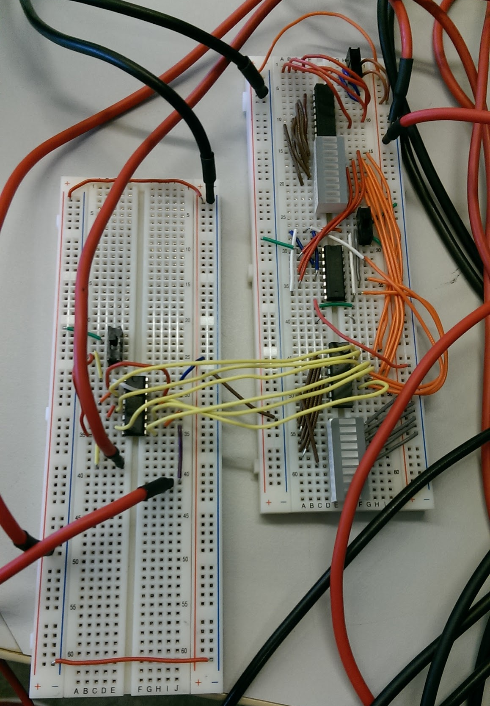
Latent Damage and Reliability in Semiconductor Devices
Burn-in PCB
------------------------------------------------------------------------------------------------------------------------------------
2nd Design
Without the new circuitry, we would need 600 extra switches for the population.
Use of the tri-states only requires one extra switch per board, compared to the 1st design.
Notes:
David

Slide 27
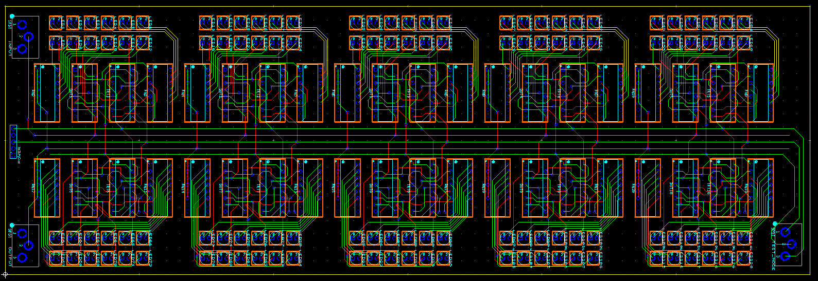
Latent Damage and Reliability in Semiconductor Devices
Burn-in PCB
------------------------------------------------------------------------------------------------------------------------------------
2nd Design
10 Testing Clusters per PCB
Notes:
Sean

Slide 28
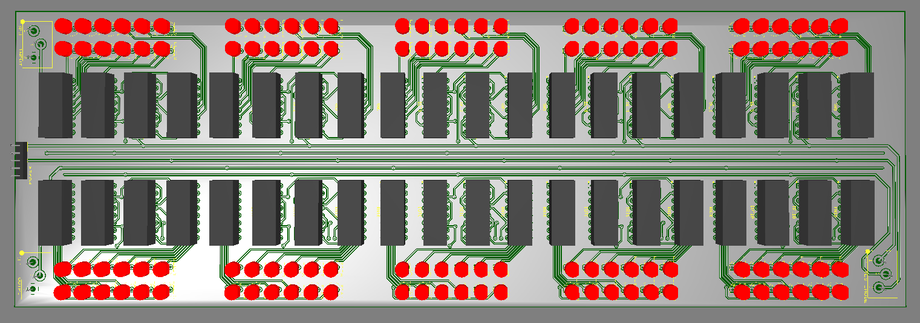
Latent Damage and Reliability in Semiconductor Devices
Burn-in PCB
------------------------------------------------------------------------------------------------------------------------------------
2nd Design
Notes:
Sean

Slide 29
Latent Damage and Reliability in Semiconductor Devices
Burn-in PCB
------------------------------------------------------------------------------------------------------------------------------------
2nd Design
Components need to withstand a temperature of 112°C
With the current design, these do not meet the specification:
SPST Slide Switch [GF-123-0054]
LED 3mm [OVLBR4C7]
The headers are okay because we can remove the plastic
Component | Temp
PCB (FR-4) | 140°C
Socket | 125°C
Hex Buffer | 125°C
Tri-St. Inverter | 125°C
Resistor Array | 125°C
Switch | 104°C
LED 3mm | 100°C
Headers (UL94V-0) | 90°C
Notes:
Sean

Slide 30
Latent Damage and Reliability in Semiconductor Devices
Reaching our Current Design
Determined issues with the 1st design of the burn-in PCB
Resistor networks bussed
DUT output gates connected
Solved the burn-in temperature with the HTOL model (112°C)
Redesigned the burn-in PCB with electronic switching circuitry
Hex tri-state inverters
Diagnosed some issues with the ESD stress PCB
Insulating varnish to eliminate arcing
Considered our safety as a great concern
Insulating varnish, properly insulated wires, soldering high-voltage circuits rather than breadboarding, etc.
Notes:
Jaehyuk

Slide 31
Latent Damage and Reliability in Semiconductor Devices
Data Analysis
Notes:
Jaehyuk

Slide 32
Latent Damage and Reliability in Semiconductor Devices
Data Analysis
--------------------------------------------------------------------------------------------------------------------------------
General Procedure
After collecting the burn-in data for the experimental group, we can compare this to the control group data.
This will require statistical analysis, however our conclusion will only be accurate to a certain confidence level.
Our primary statistic of interest will be the difference in MTTF between the experimental and the control group.
Notes:
Jaehyuk

Slide 33
Latent Damage and Reliability in Semiconductor Devices
Completed Work
Replaced the programmable high-voltage source
Determined issues and intended operation of existing PCB’s
Breadboard implementation of 1st burn-in PCB design
Added second functionality to burn-in PCB
High-stress mode
Calculated the burn-in temperature (112°C)
Created 2nd burn-in PCB design
Attempted to stress devices while troubleshooting high-voltage source
Notes:
Hayle

Slide 34
Latent Damage and Reliability in Semiconductor Devices
Future Considerations
Establish maximum stress level with ESD Stress System
Stress devices to create Experimental Group
Replace burn-in PCB components
Must be rated at 112°C
Fabricate 10 burn-in PCBs and order components
Populate and solder burn-in PCB components
Accelerate lifetime of devices (burn-in)
Control Group
Experimental Group
Record data during burn-in of individual failing inverters
Analyze data to either confirm or deny hypothesis
Only to a certain degree of confidence
Notes:
Sean

Slide 35
Latent Damage and Reliability in Semiconductor Devices
Thank you!
Any Questions?
Notes:
Sean

Slide 36
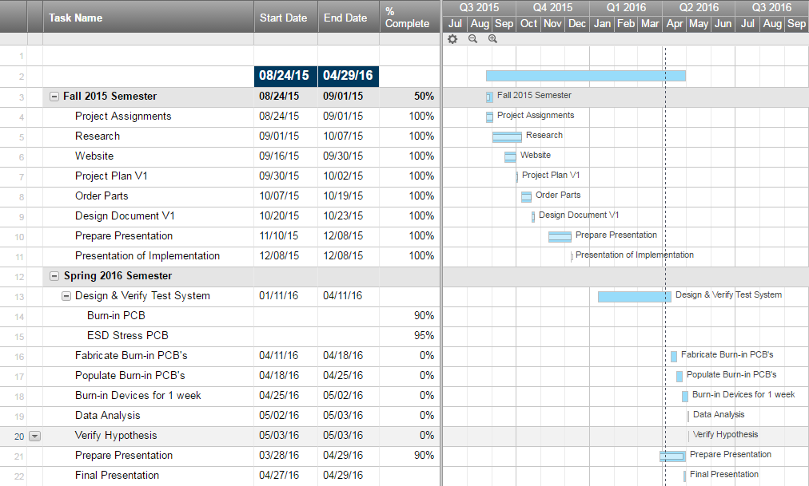
Latent Damage and Reliability in Semiconductor Devices
Project Milestones & Schedule
Updated on April 5th, 2016
Notes:
Gantt Chart

Slide 37
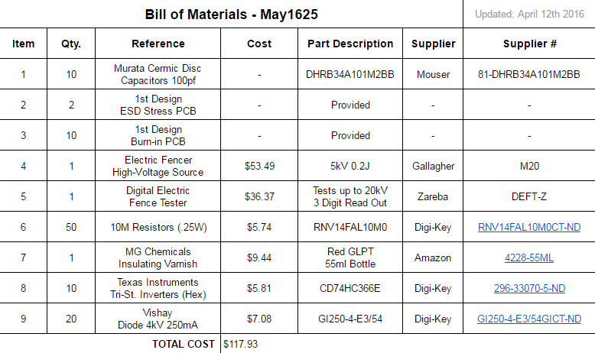
Latent Damage and Reliability in Semiconductor Devices
Resource/Cost Estimate

Slide 38
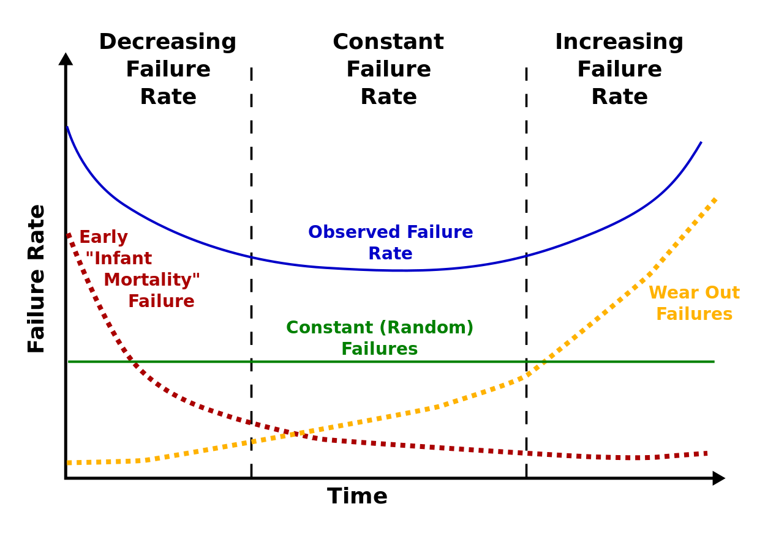
Latent Damage and Reliability in Semiconductor Devices
Semiconductor Reliability
---------------------------------------------------------------------------------------------------------------------------------------------------------------------------------------------------------------
Bathtub Curve
Source: www.en.wikipedia.org/wiki/Bathtub_curve
Notes:
https://en.wikipedia.org/wiki/Bathtub_curve

Slide 39
Latent Damage and Reliability in Semiconductor Devices
Burn-in
---------------------------------------------------------------------------------------------------------------------------------------------------------------------------------------------------------------
Calculations - HTOL Model
Source: www.microsemi.com
Variables:
A_{f}: acceleration factor D: number of devices tested (100 devices)
k: Boltzmann’s Constant H: test hours per device (168 hours = 1 week)
E_{a}: activation energy (eV) EDH: equivalent device hours
T: temperature (Kelvin) r: number of failures (50 fails)
Failures in Time (FIT) to Mean Time to Failure (MTTF):
FIT = λ_{FIT} = λ_{hours} × 10⁹ (Failure rate (λ) per billion hours)
MTTF_{hours} = 1/λ_{hours} (Mean Time to Failure)
Notes:
http://www.microsemi.com/document-portal/doc_view/124041-calculating-reliability-using-fit-mttf-arrhenius-htol-model

Slide 40
Latent Damage and Reliability in Semiconductor Devices
Burn-in
---------------------------------------------------------------------------------------------------------------------------------------------------------------------------------------------------------------
Calculations - HTOL Model
Source: www.microsemi.com
MTTF_{years} = 20
MTTF_{hours} = 8760 × MTTF_{years} = 8760 × (20) ⇒ MTTF_{hours} = 175,200
λ_{hours} = 1/MTTF_{hours} = 1/(175,200) ⇒ λ_{hours} = 5.708 × 10⁻⁶ fails/hour
EDH = r/λ_{hours} = (50 fails)/(5.708 × 10⁻⁶ fails/hour) ⇒ EDH = 8,760,000 hours
A_{f} = EDH/(D × H) = (8,760,000 hours)/(100 × 168 hours) ⇒ A_{f} = 521.43
Solve for T_{test} to determine burn-in temperature:
⇒ T_{test} = 384.69K ≈ 112°C
Notes:
http://www.microsemi.com/document-portal/doc_view/124041-calculating-reliability-using-fit-mttf-arrhenius-htol-model

